Slide 1
Presented by:
Mark Iredell based on work done by Global Climate and Weather Modeling Branch
EMC FY15Q1 Upgrade Review
GFS upgrade

Slide 2
Implementation Overview
  This upgrade is planned for December 9, 2014
  System description
    This is a change to the GDAS and GFS.
  What’s being changed in the system
    Analysis
    Model
      T1534 (to 10 days) Semi-Lagrangian
      Use of high resolution daily SST and sea ice analysis
      Physics
      Land Surface
    Post Processor
  Expected benefits to end users associated with upgrade
    Upgrade in global modeling capability.
    Improvement in forecast skill
  This implementation will put GFS/GDAS into EE process.

Slide 3
Analysis Highlights
Structure
  T574 (35 km) analysis for T1534 (13 km) deterministic
  Code optimization
Observations
  GPSRO enhancements – improve quality control
  Updates to radiance assimilation
    Assimilate SSM/IS UPP LAS and MetOp-B IASI radiances
    CRTM v2.1.3
    New enhanced radiance bias correction scheme
    Additional satellite wind data – hourly GOES, EUMETSAT
EnKF modifications
  Stochastic physics in ensemble forecast
  T574L64 EnKF ensembles

Slide 4
Model Highlights (1)
T1534 Semi-Lagrangian (~13 km)
Use of high resolution daily SST and sea ice analysis
High resolution until 10 days
Dynamics and structure upgrades
  Hermite interpolation in the vertical to reduce stratospheric temperature cold bias.
  Restructured physics and dynamics restart fields and updated sigio library
  Divergence damping in the stratosphere to reduce noise
  Added a tracer fixer for maintaining global column ozone mass
  Major effort to make code reproducible

Slide 5
Model Highlights (2)
Physics upgrades
  Radiation modifications -- McICA
  Reduced drag coefficient at high wind speeds
  Hybrid EDMF PBL scheme and TKE dissipative heating
  Retuned ice and water cloud conversion rates, background diffusion of momentum and heat, orographic gravity-wave forcing and mountain block etc
  Stationary convective gravity wave drag
  Modified initialization to reduce a sharp decrease in cloud water in the first model time step
  Correct a bug in the condensation calculation after the digital filter is applied

Slide 6
Model Highlights (3)
Boundary condition input and output upgrades
  Consistent diagnosis of snow accumulation in post and model
  Compute and output frozen precipitation fraction
  New blended snow analysis to reduce reliance on AFWA snow
  Changes to treatment of lake ice to remove unfrozen lake in winter
  Land Surface
    Replace Bucket soil moisture climatology by CFS/GLDAS
    Add the vegetation dependence to the ratio of the thermal and momentum roughness, Fixed a momentum roughness issue

Slide 7
Post - Processer Highlights
Faster/less memory version
GRIB2 with parallel output
Master post file is 0.25 degree, not model Gaussian grid
Accumulation bucket changed from 12 hour to 6 hour between day 8 and day 10
Add user requested fields
  frozen precipitation fraction
  ozone at 150, 200, 250, 300, 350, and 400 mb,
  2m dew point,
  wind chill and heat index,
  instantaneous precipitation type
  membrane SLP in GDAS pgb files
  Improved icing algorithm in post
  Higher precision RH
  GDAS output symmetric with GFS
BUFR station list to newer NAM/GFS list

Slide 8
Parallel Status
All components of the system , including Storm-Relocation, OBSPROC, EMC-Surface, GSI, ENKF, GSM, Post-processing, were built in the EE structure, are frozen, and have been handed off to NCO for implementation.
NCO is working on setting up a 30-day pre-implementation parallel, which will be run on the development machine.
Parallels and verification pages
  Prhs14: 01/01/2014 ~ present running
    http://www.emc.ncep.noaa.gov/gmb/wd20rt/vsdb/prhw14
  Prhs13: 05/16/2013 ~ 12/31/2013 completed
    http://www.emc.ncep.noaa.gov/gmb/wd20rt/vsdb/prhs13
  Prhs12: 05/01/2012 ~ 11/06/2012 completed
    http://www.emc.ncep.noaa.gov/gmb/wd20rt/vsdb/prhs12
  Prhs11: 05/20/2011 ~ 12/31/2011 completed (on Zeus)
    http://www.emc.ncep.noaa.gov/gmb/wx24fy/vsdb/prhs11
    http://www.emc.ncep.noaa.gov/gmb/wx24fy/vsdb/prhs11b/
merged 2012/2013/2014 http://www.emc.ncep.noaa.gov/gmb/wx24fy/vsdb/gfs2015/

Slide 9
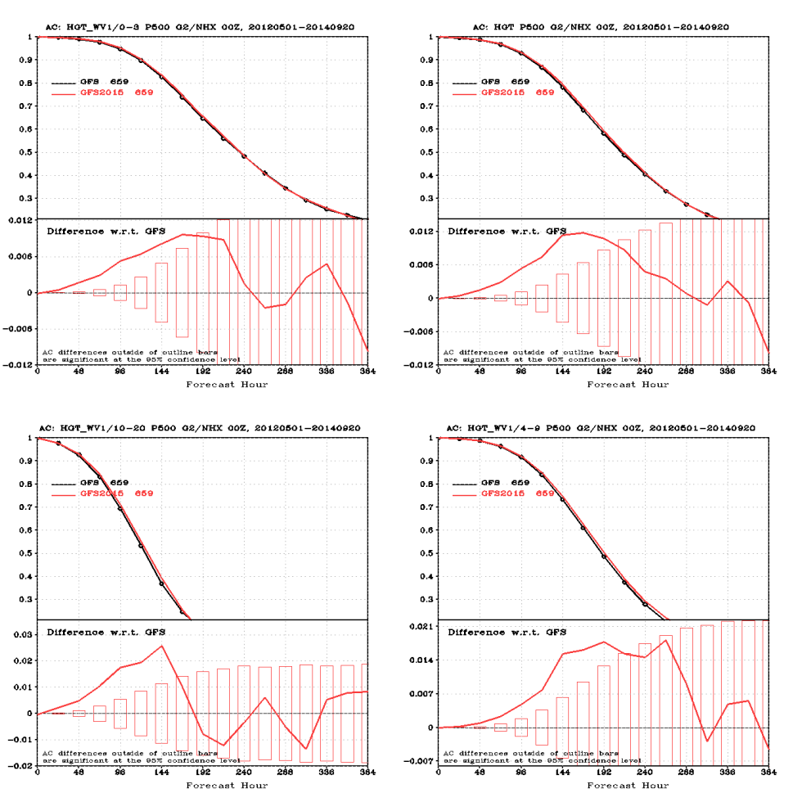
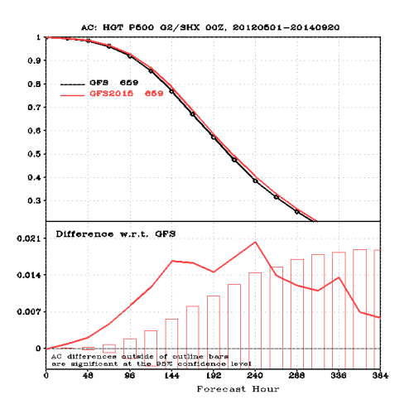
Results – Merged 2012/2013/2014
see http://www.emc.ncep.noaa.gov/gmb/wx24fy/vsdb/gfs2015/ for more detail. Note that Hybrid ENKF 3D-VAR GSI was implemented into operation after May 22, 2012
NH 500-hPa HGT AC
SH 500-hPa HGT AC
Link to scorecard
http://www.emc.ncep.noaa.gov/gmb/wx24fy/vsdb/gfs2015/www/scorecard/mainindex.html
9

Slide 10
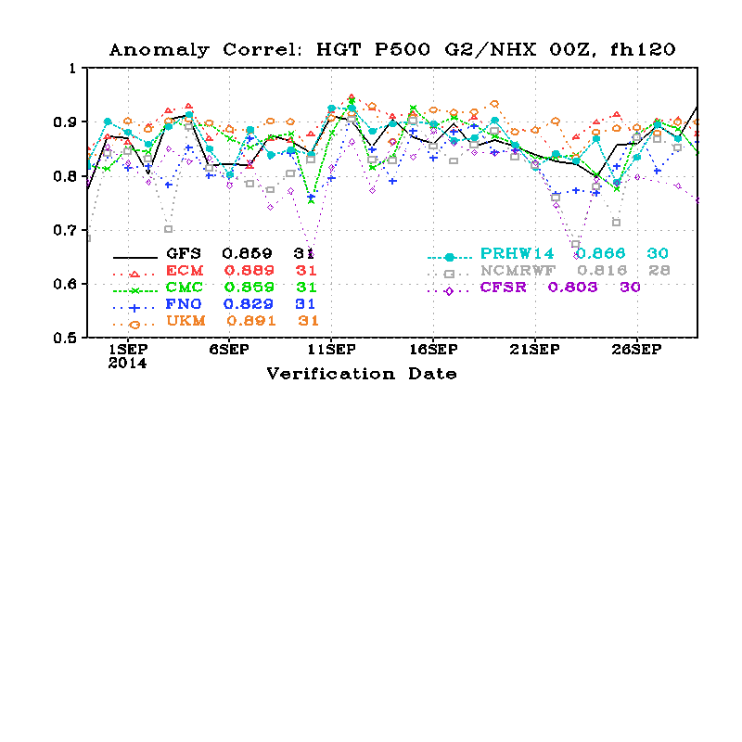
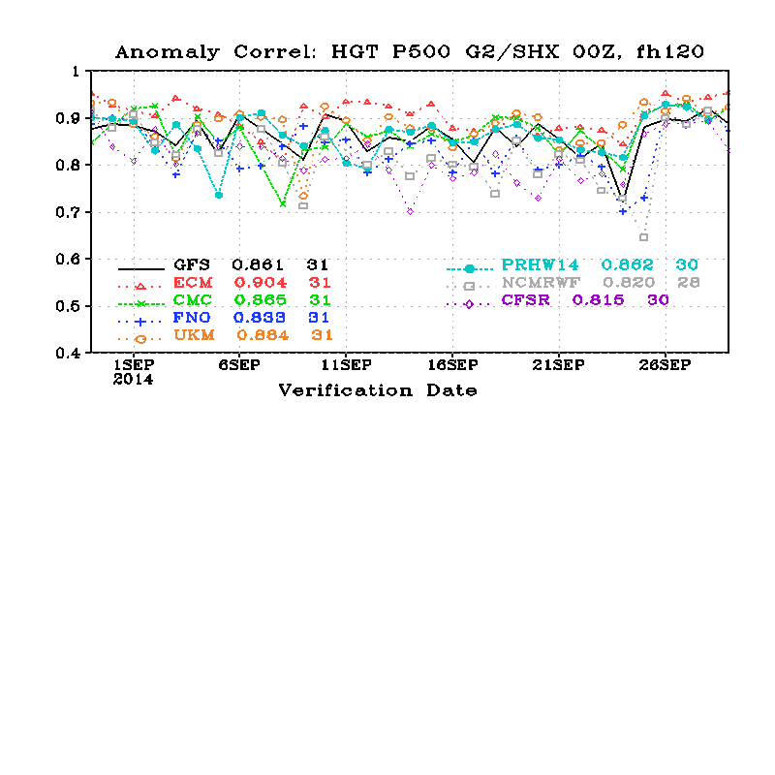
Real-Time Parallel in the past 31 Days
NH 500-hPa HGT AC
Prhw14 is T1534 parallels
SH 500-hPa HGT AC
http://www.emc.ncep.noaa.gov/gmb/STATS_vsdb/
10

Slide 11
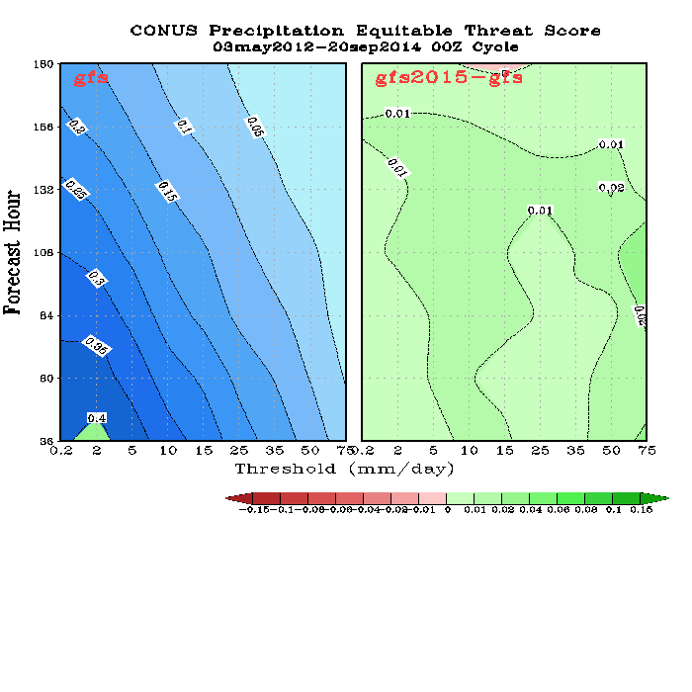
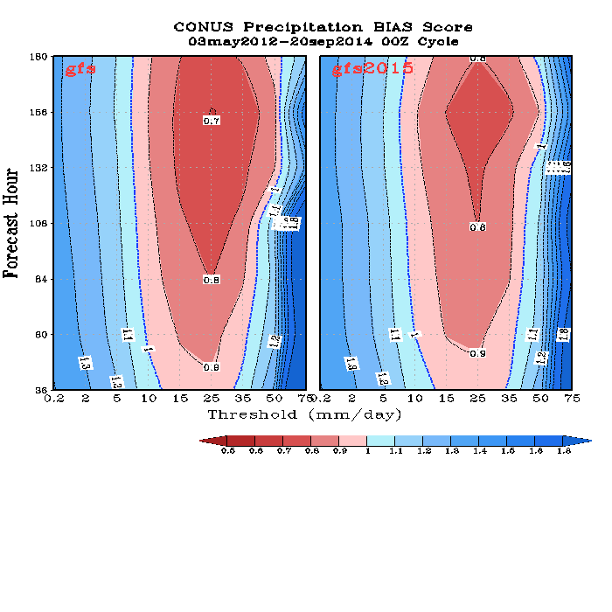
Precipitation Skill Scores, 00Z Cycle
Merged 2012/2013/2014
ETS
BIAS
Improved ETS score and reduced forecast BIAS for all intensity and forecast lead time.
11

Slide 12
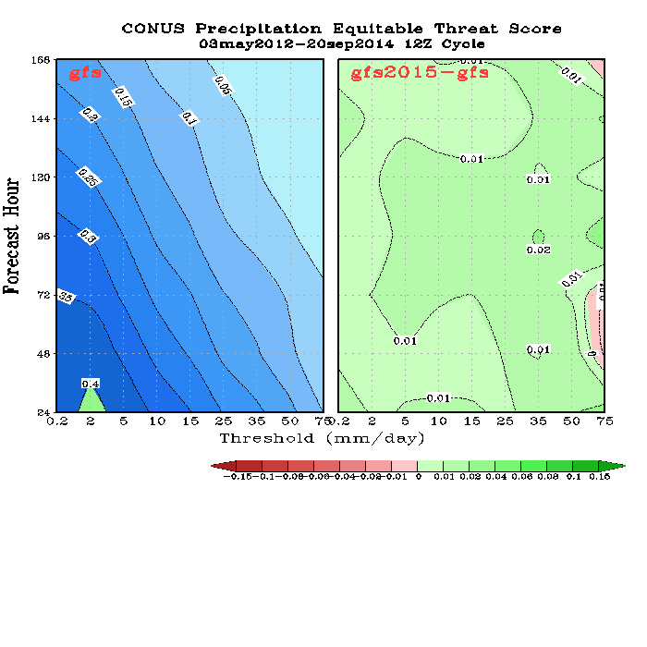
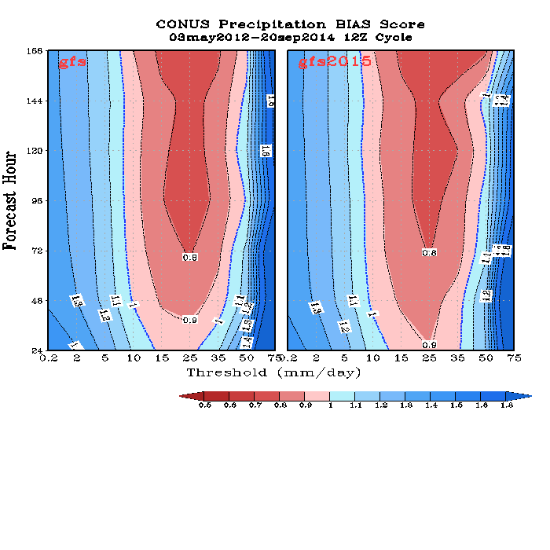
Precipitation Skill Scores, 12Z cycle
Merged 2012/2013/2014
Improved ETS score and slightly reduced forecast BIAS for all intensity and forecast lead time.
12

Slide 13
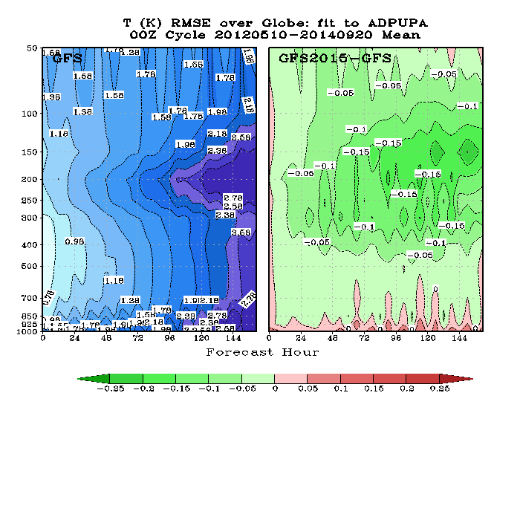
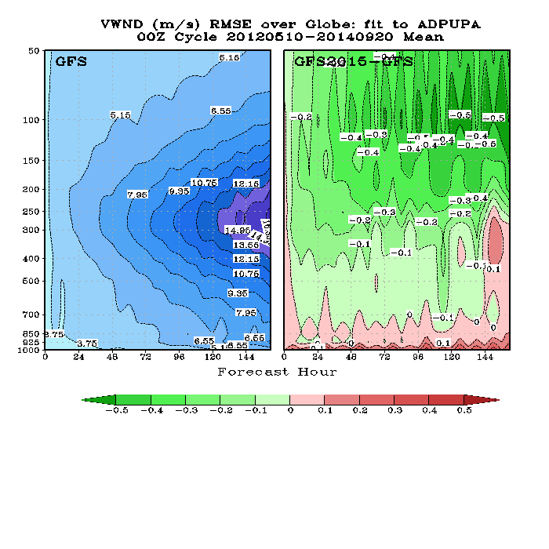
Fit to RAOBS, RMSE
Merged 2012/2013/2014
Global Mean Temperature RMSE
Global Mean Wind RMSE
http://www.emc.ncep.noaa.gov/gmb/wx24fy/vsdb/gfs2015/g2o/index.html
13

Slide 14
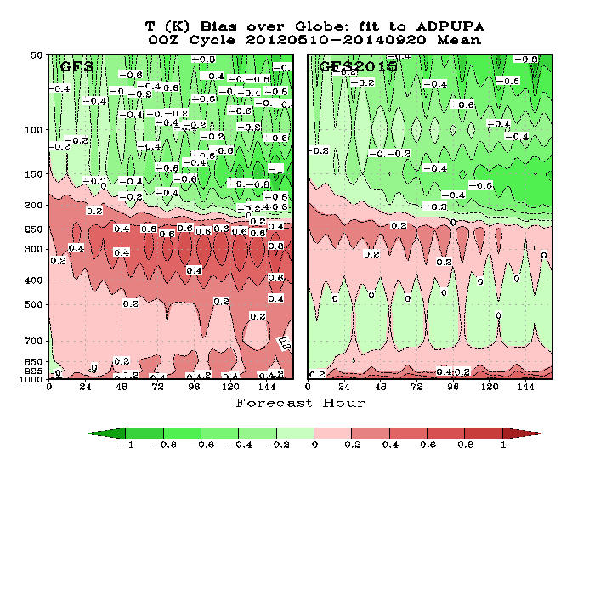
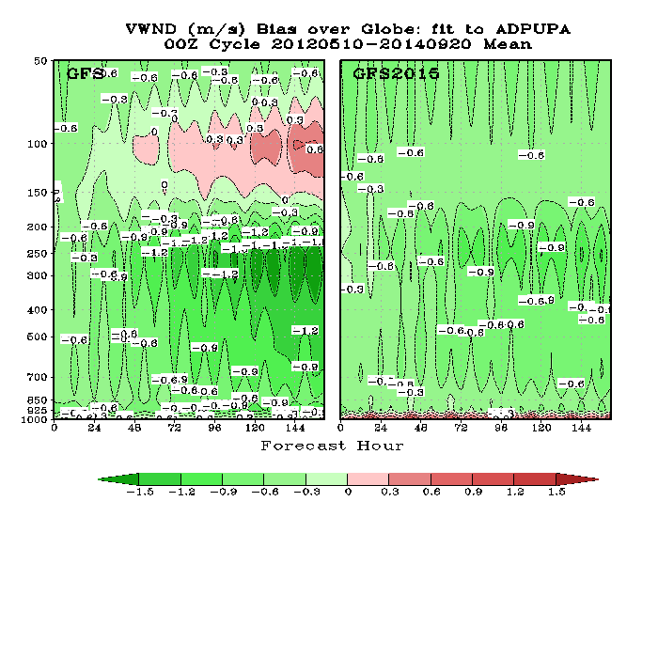
Fit to RAOBS, Bias
Merged 2012/2013/2014
Global Mean Temperature Bias
Global Mean Wind Bias
Reduced tropospheric warm bias, increased near surface warm bias
Strengthened tropospheric wind, slightly weakened stratospheric wind
14

Slide 15
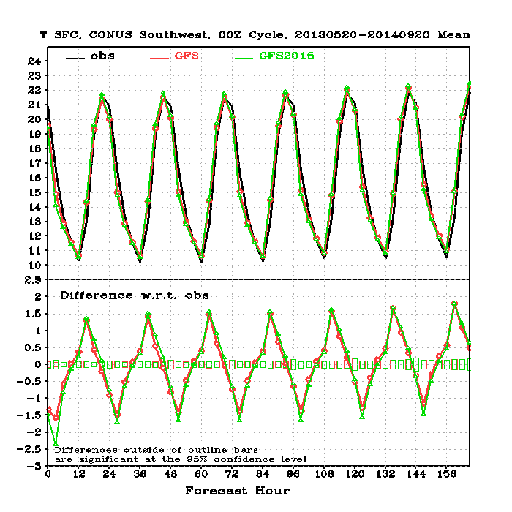
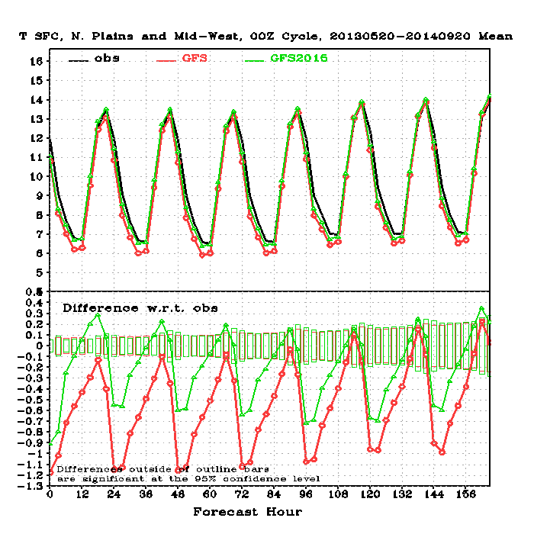
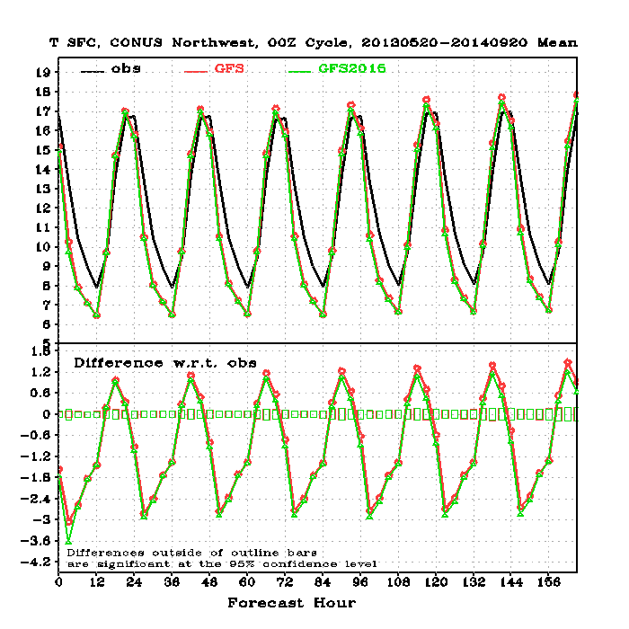
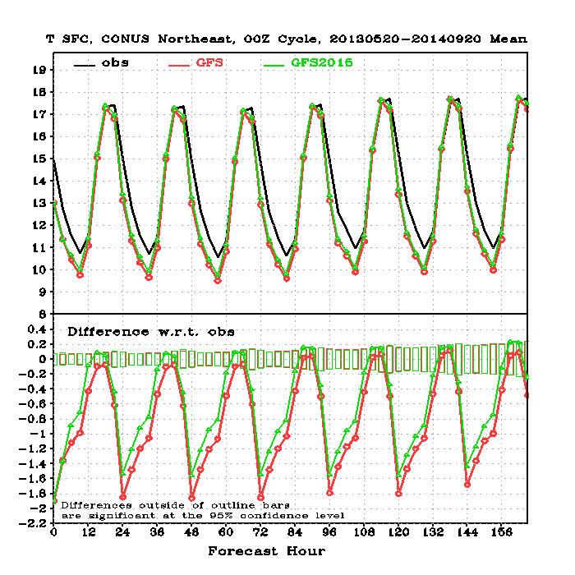
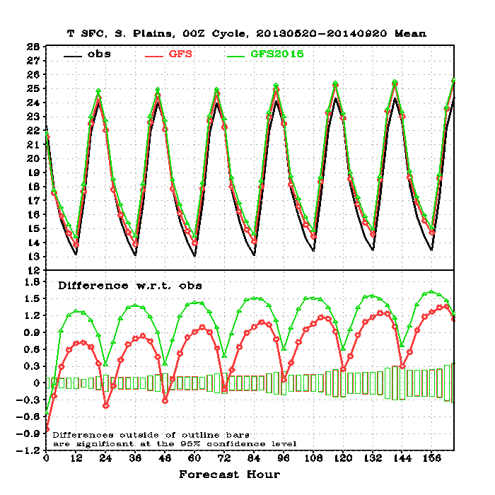
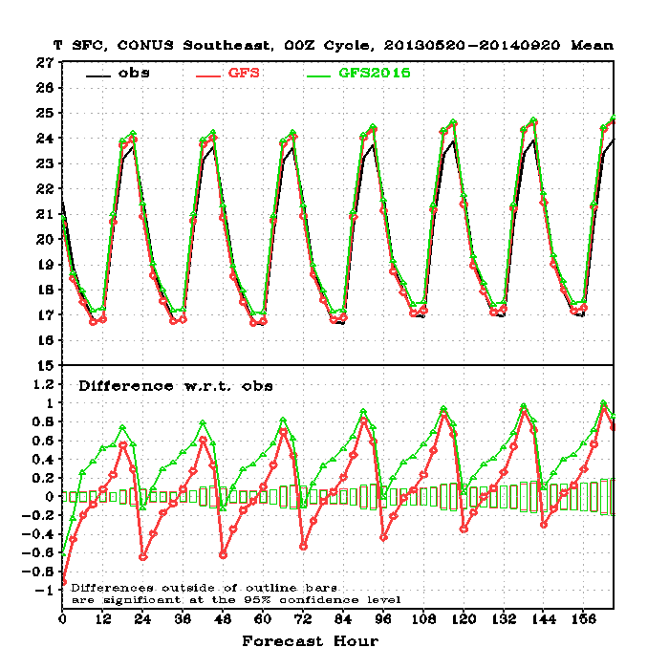
CONUS T2m, Fit to Sfc Obs
Merged 2013/2014
Northwest
Northern Plains
Reduced nighttime cold bias
Southwest
Northeast
Southern Plains
Southeast
15

Slide 16
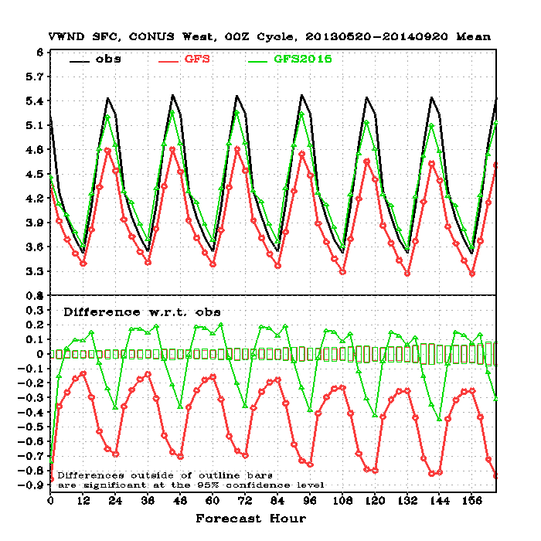
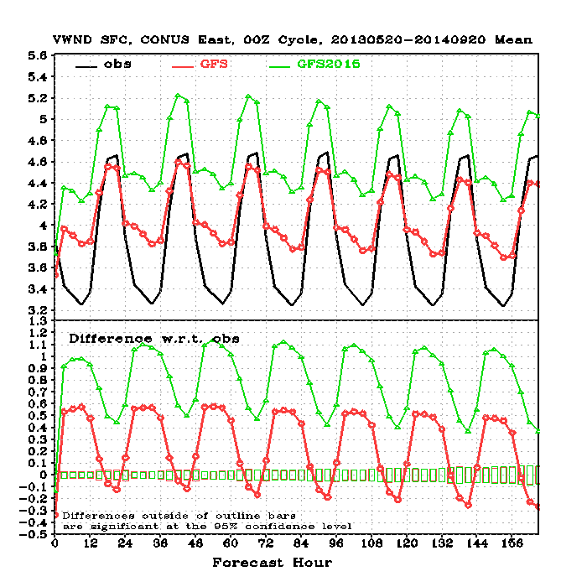
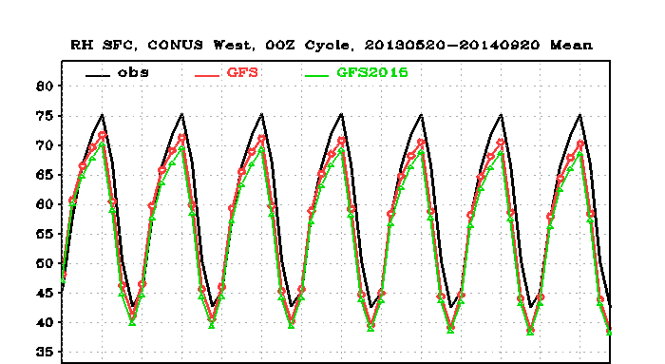
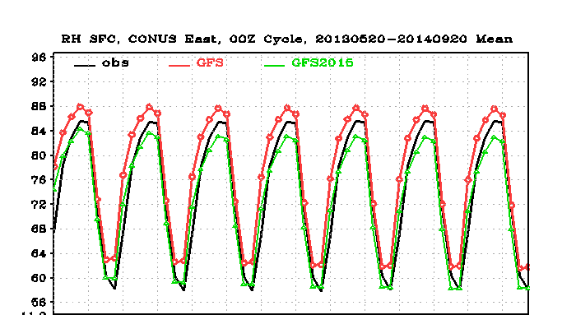
10-m Wind and 2m RH, Fit to Sfc Obs
Merged 2013/2014
10m Wind
CONUS West
CONUS East
CONUS West
2m RH
CONUS West
CONUS East
16

Slide 17
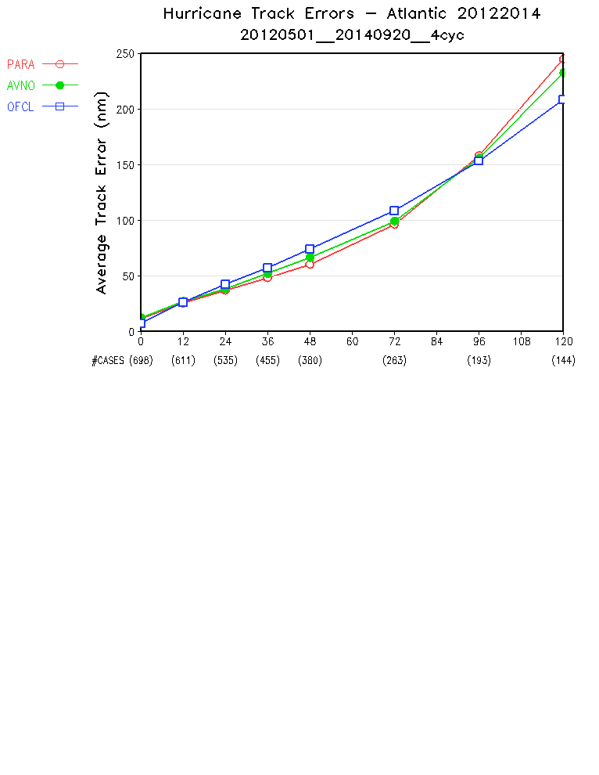
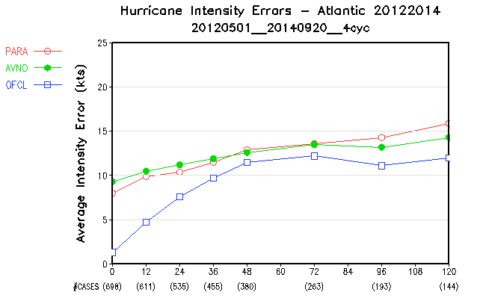
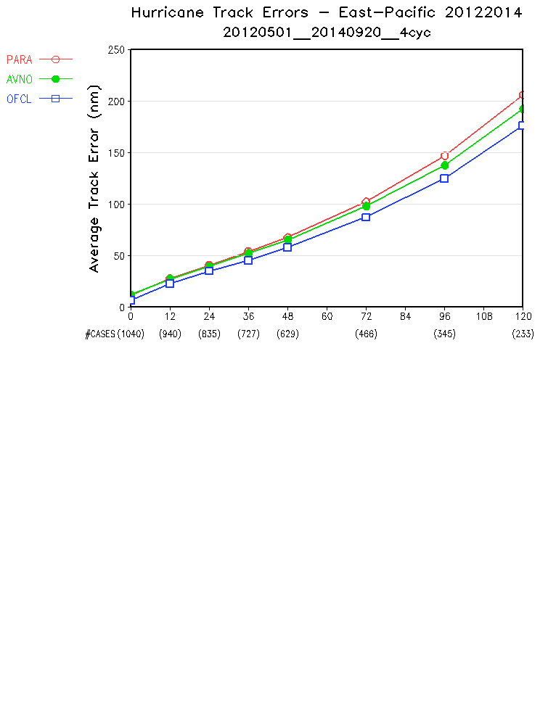
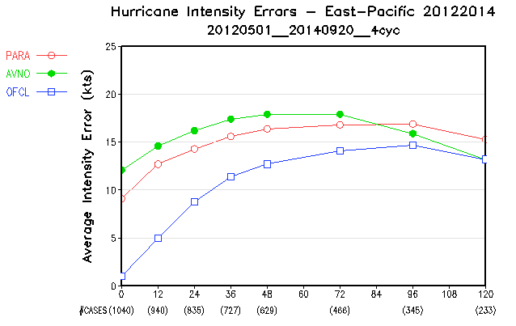
Hurricane Verification 2012/2013/2014
Atlantic Track
Atlantic Intensity
Eastern Pacific Track
Eastern Pacific Intensity
17

Slide 18
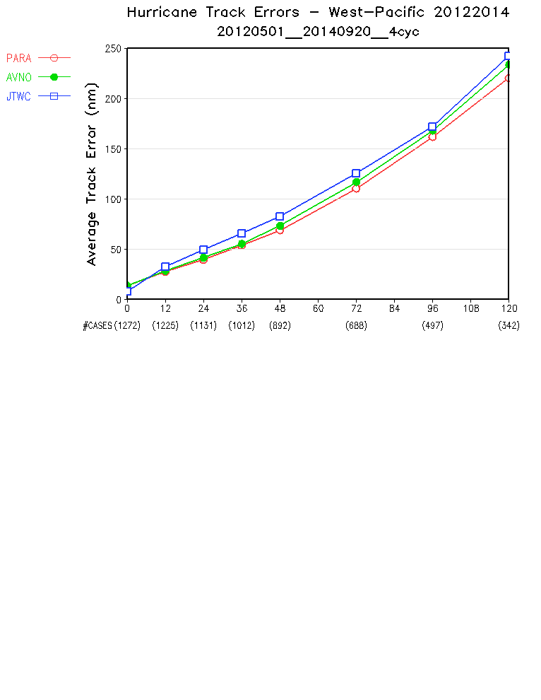
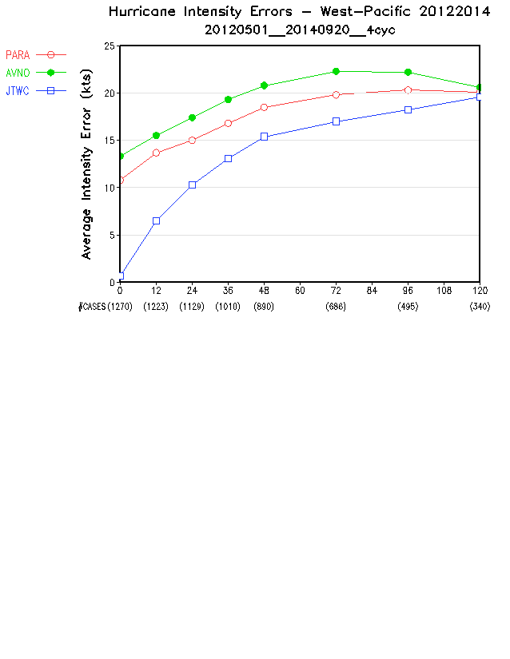
Hurricane Verification 2012/2013/2014
Western Pacific Track
Western Pacific Intensity
18

Slide 19
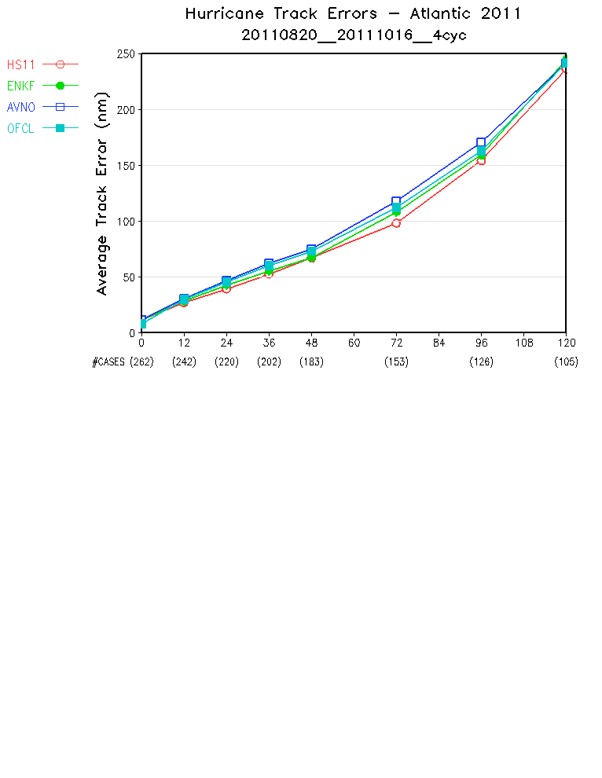
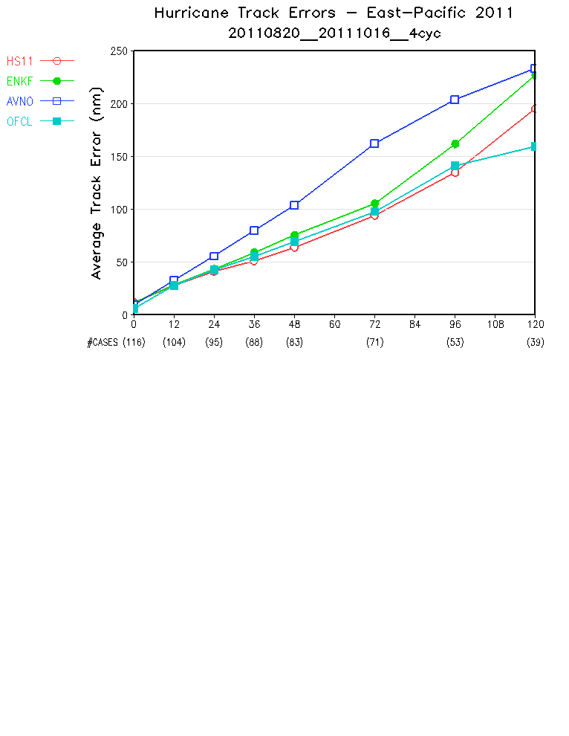
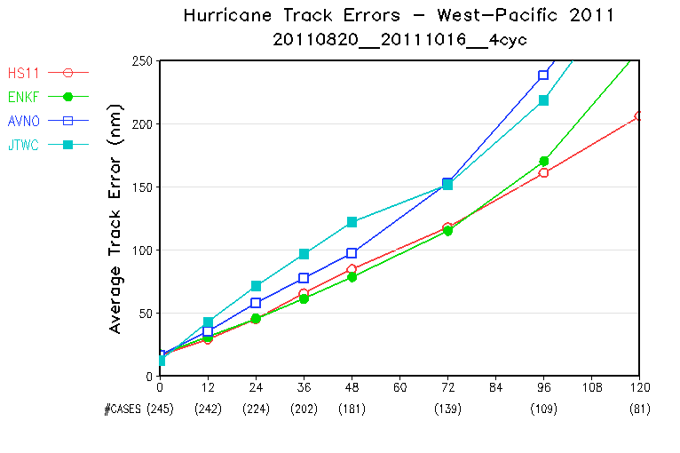
Hurricane Track Verification, 2011
HS11: T1534 parallel
ENKF: T574 ENKF-3DVAR parallel
ENKF was run only for part of the 2011 hurricane season (08/20/2011 – 10/16/2011)
Atlantic
Eastern Pacific
Western Pacific
19

Slide 20
2012 Hurricane Sandy
Summary:
At day 7, HS12 is significantly better than AVNO. HS12 showed the tendency to move Sandy northwestward.
At day 6, HS12 is slightly better than AVNO, but the difference is small.
At day-5 and day-4, the results are mixed. HS12 is better than AVNO for certain cycles but worse for other cycles.
At day 3 and less, HS12 is much better than AVNO. HS12 forecast is as good as or slightly better than ECMWF forecast.
Overall, the forecast of hurricane Sandy’s track is improved in the experimental T1534 semi-lag GFS in comparison with the operational T574 Eulerian GFS. The improvement is most significant for short-lead forecast within 72 hours. Long-lead 6 to 7-day forecasts showed improvement for certain cycles.
20

Slide 21
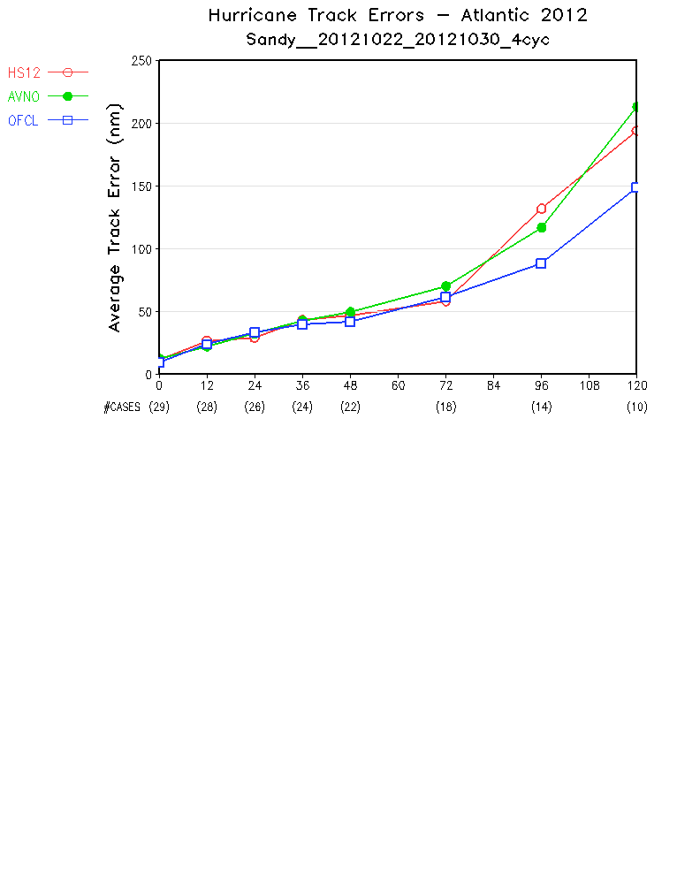
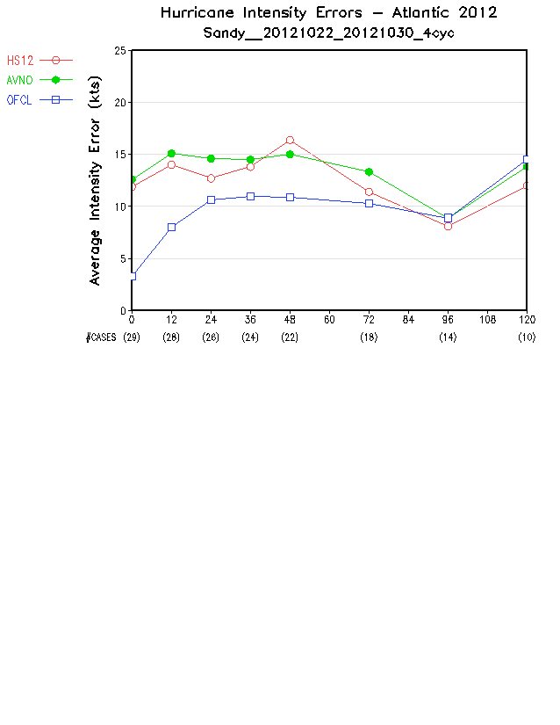
Mean Track and Intensity Errors
22 - 30 October 2012, 4 cycles/day
21

Slide 22
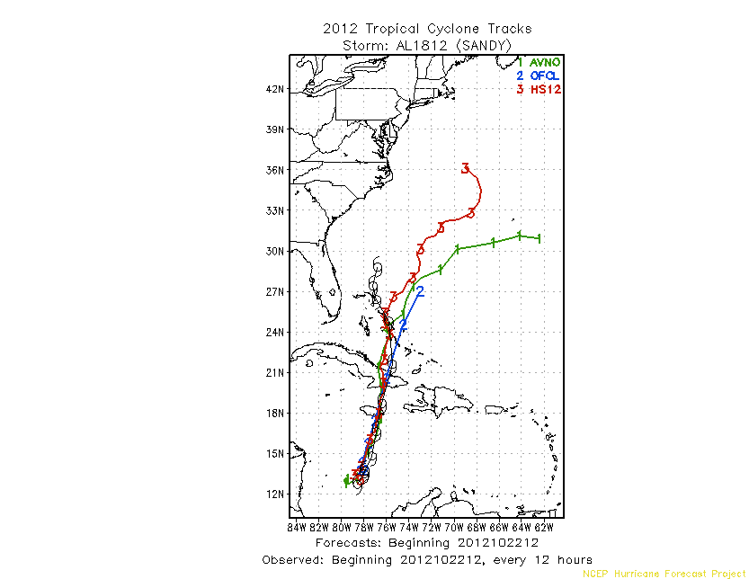
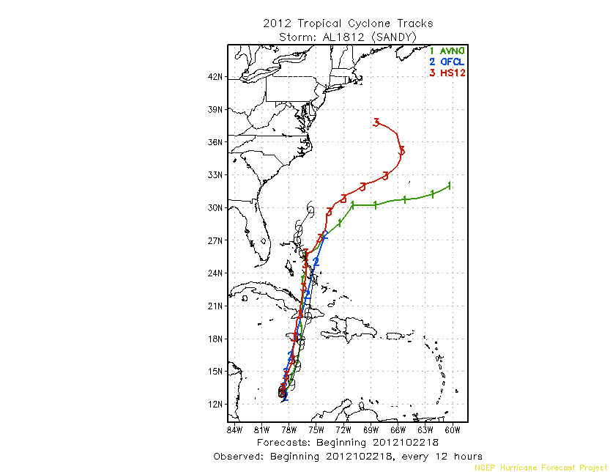
Tracks from Forecast Cycles 20121022: 12Z and 18Z
7 days before landfall
12Z
18Z
22

Slide 23
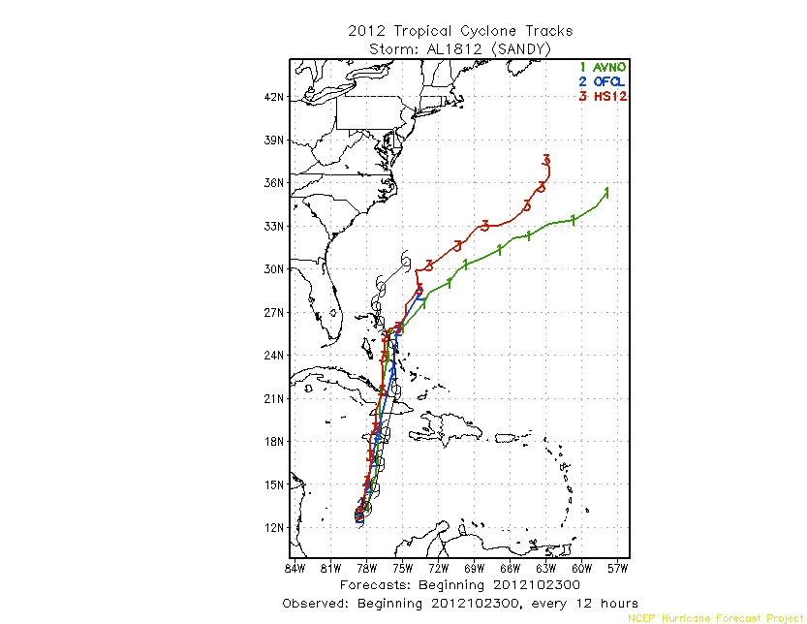
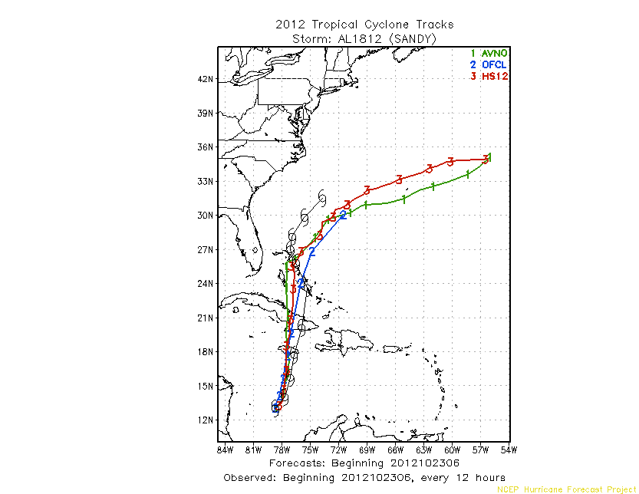
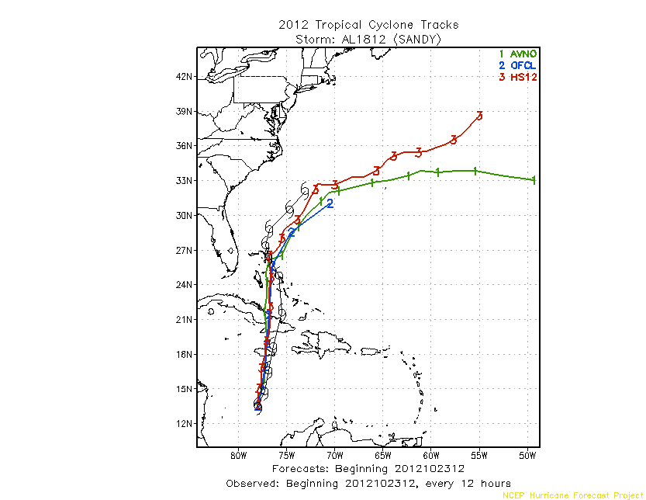
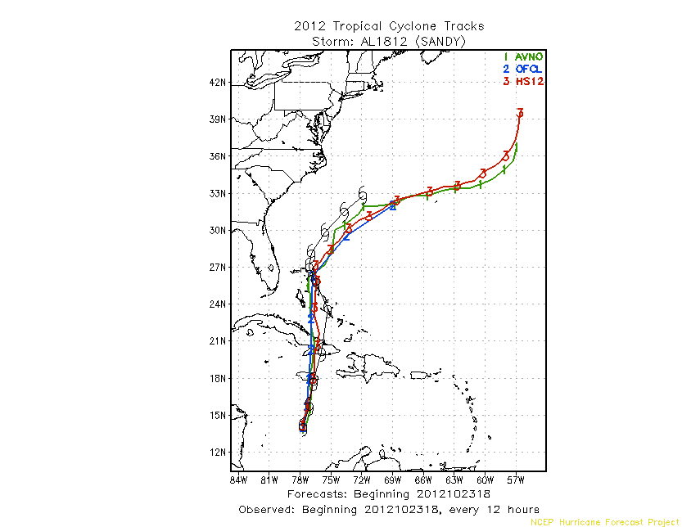
Tracks from 20121023: 00Z, 06Z, 12Z and 18Z Cycles
6 days before landfall
00Z
06Z
18Z
12Z
23

Slide 24
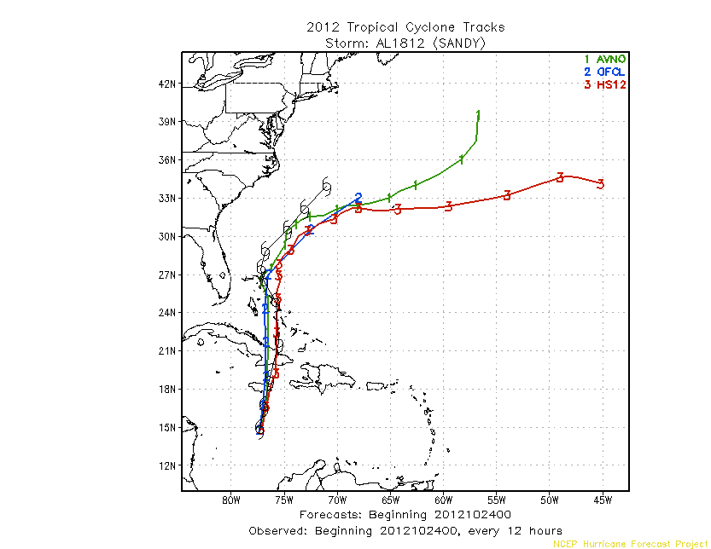
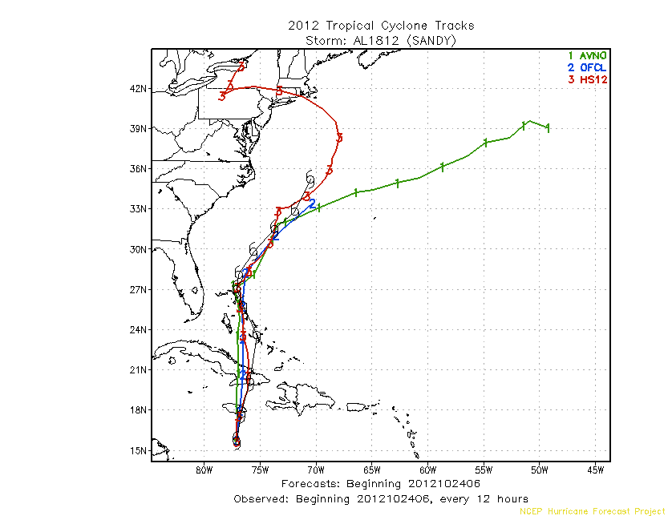
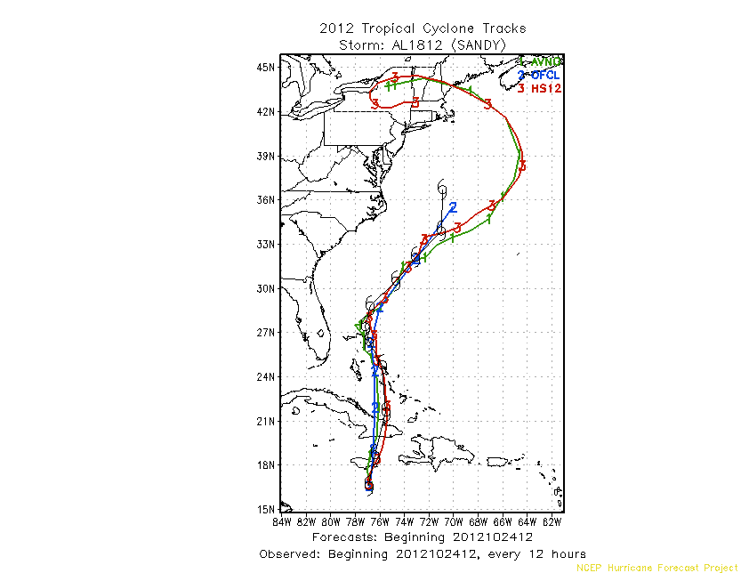
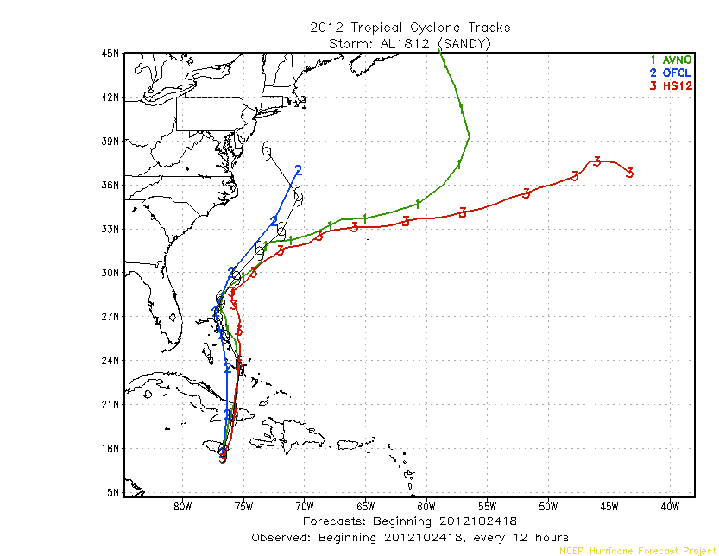
Tracks from 20121024: 00Z, 06Z, 12Z and 18Z Cycles
5 days before landfall
00Z
06Z
18Z
12Z
24

Slide 25
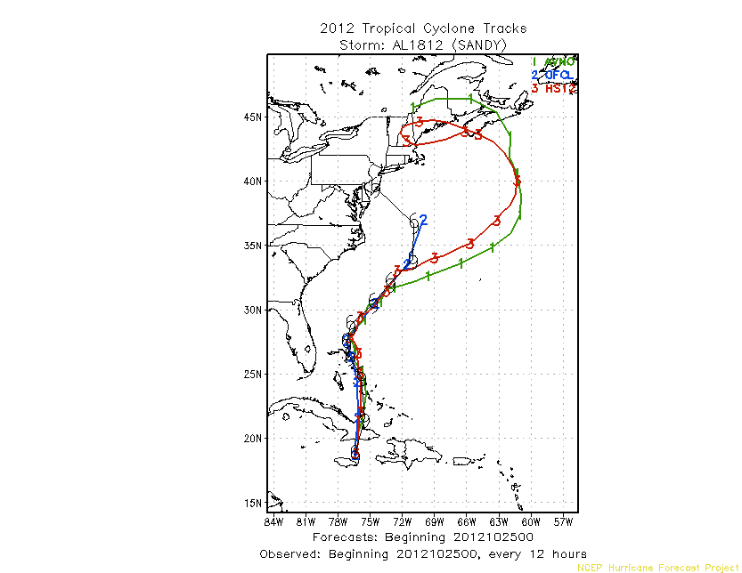
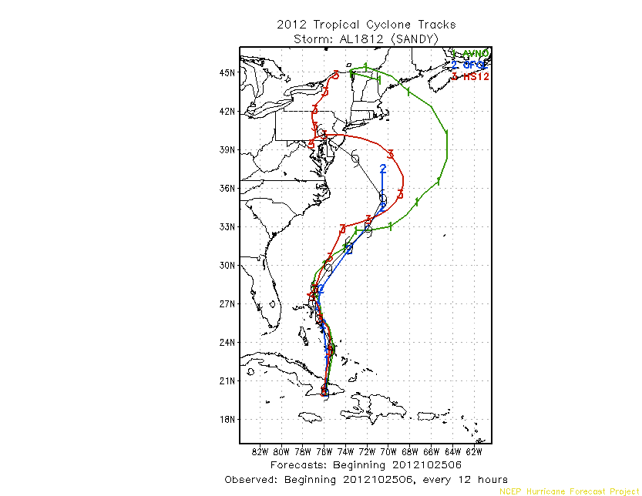
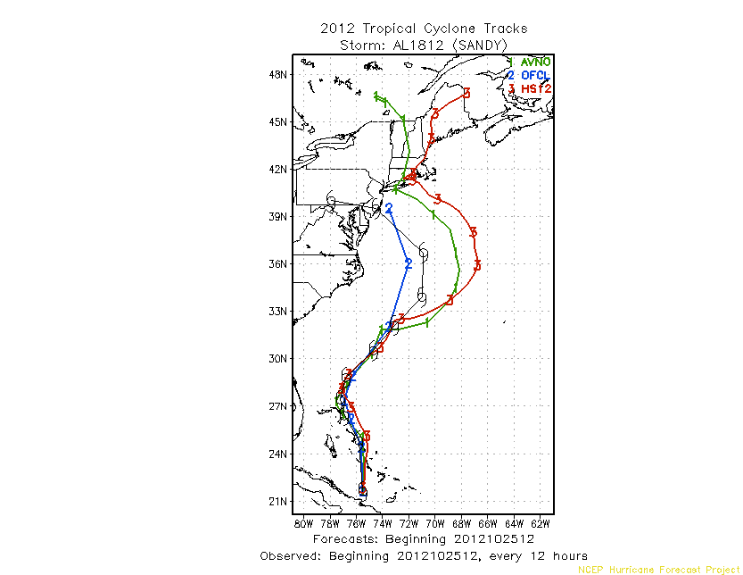
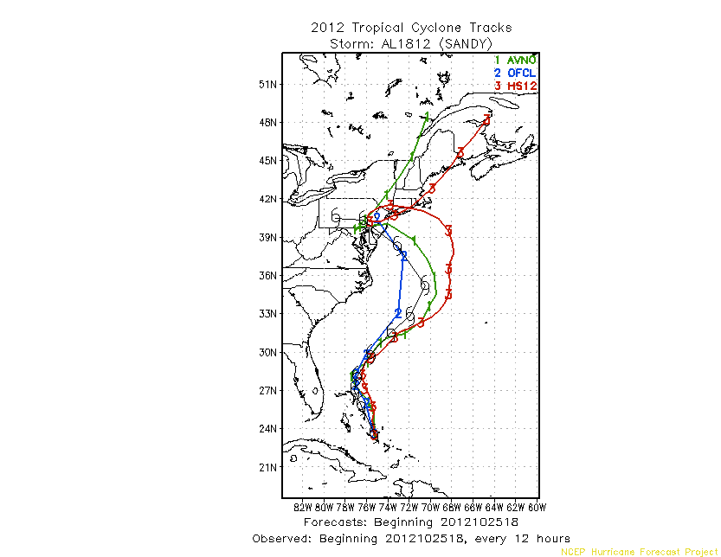
Tracks from 20121025: 00Z, 06Z, 12Z and 18Z Cycles
4 days before landfall
06Z
00Z
06Z
18Z
12Z
25

Slide 26
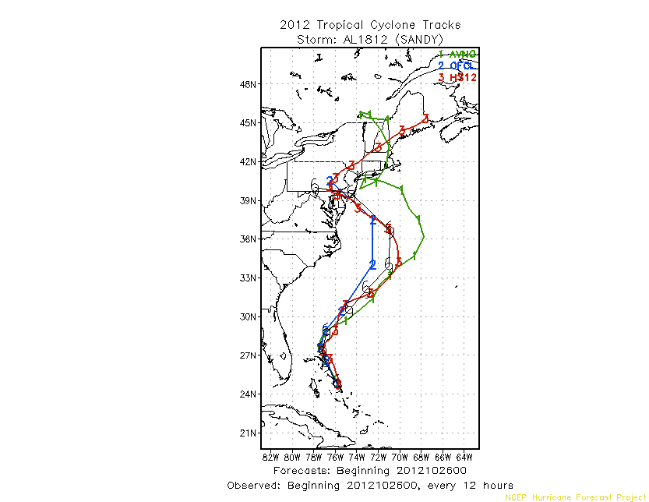
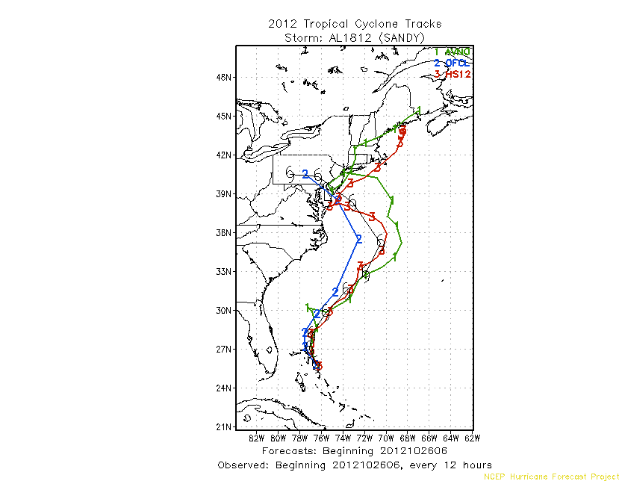
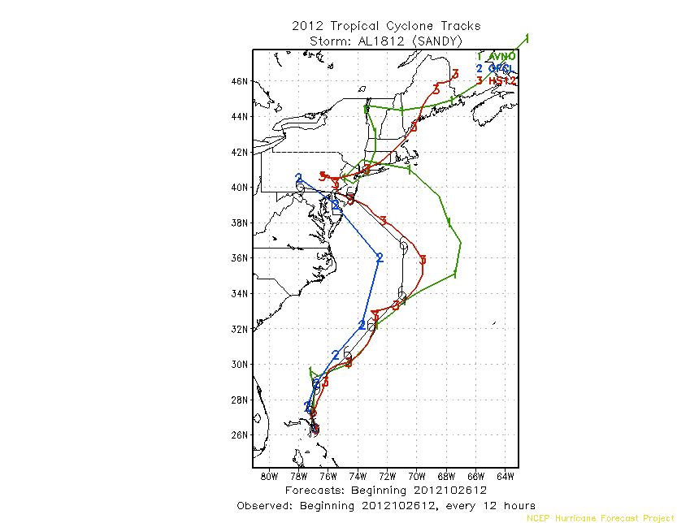

Tracks from 20121026: 00Z, 06Z, 12Z and 18Z Cycles
3 days before landfall
00Z
06Z
12Z
18Z
26

Slide 27

Extratropical Cyclone Track Errors (fcst cs analy)
June-Aug 2014 (Lat > 20N/S)
Courtesy of Guang Ping Luo
fcst hr | 0 | 12 | 24 | 36 | 48 | 60 | 72 | 84 | 96 | 108 | 120
NH cases | 2145 | 1995 | 1752 | 1248 | 793 | 513 | 331 | 217 | 135 | 97 | 71
SH cases | 1880 | 1742 | 1545 | 1014 | 564 | 309 | 157 | 79 | 43 | 19 | 8

Slide 28
Summary
All codes are now frozen, built in EE structure, and handed off to NCO for implementation.
Results are reasonable
  Improved precipitation skill scores
  Improved hurricane track in Atlantic and Western Pacific, but worsened in Eastern Pacific; Reduced intensity errors in all basins.
  Reduced mid-latitude storm track errors.
  Reduced global mean temperature bias in the upper troposphere; strengthened (improved) tropospheric winds but slightly weakened stratospheric winds.
  Reduced nighttime 2m temperature cold bias over the Northern Great Plains. Large biases still exist in Northeast and Southwest.
  improved 500-hPa HGT AC in both the Northern and Southern Hemispheres.

